Slide 1
Properties of waves day 1
10/11 & 10/12

Slide 2
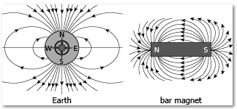
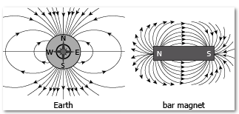
DQ:
A bar magnet and Earth both have magnetic fields. Which diagram correctly represents the magnetic field lines of a bar magnet and Earth?
A.
B.
Standard 8.PS4.1

Slide 3
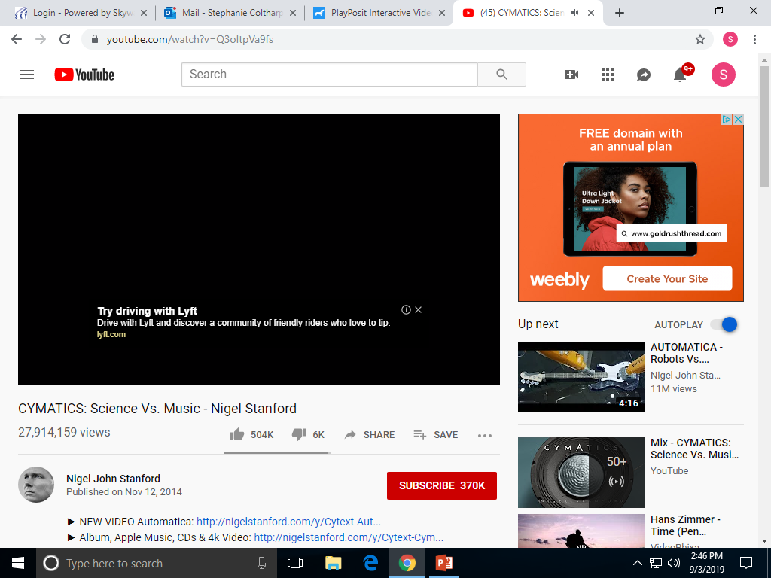
WAVES PHENOMENON
Write Your questions and observations on your paper as we watch the video.
1. Properties of Waves initial model
Standard 8.PS4.1

Slide 4
1. Properties of Waves initial model
Discuss with your lab tables and be ready to share 1 question with the whole group.
Class Guiding question:
Standard 8.PS4.1

Slide 5
Properties of Waves Stations
Textbook pages 96-115
PhET simulation – Waves on a String (go to TEAMS for the link)
Slinky Lab
Playposit – Properties of Waves (go to TEAMS for the link)
Revise your initial model after you complete the stations.
Standard 8.PS4.1

Slide 6
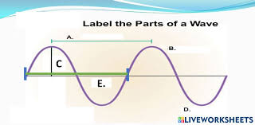
Exit ticket:
What are the parts of this wave?

